Slide 1
INFDEV036A - Algorithms Lesson Unit 6
G. Costantini, F. Di Giacomo
costg@hr.nl, giacf@hr.nl – Office H4.206

Slide 2
Today
Why is my code slow?
Empirical and complexity analysis
How do I order my data?
Sorting algorithms
How do I structure my data?
Linear, tabular, recursive data structures
How do I represent relationship networks?
Graphs

Slide 3
More detailed agenda
What is dynamic programming?
Fibonacci example; memoization and bottom-up approaches
How can we find the shortest paths between all pairs of nodes in a graph?
Floyd Warshall algorithm

Slide 4
Dynamic Programming
Fibonacci sequence, Memoization, Bottom up, General idea

Slide 5
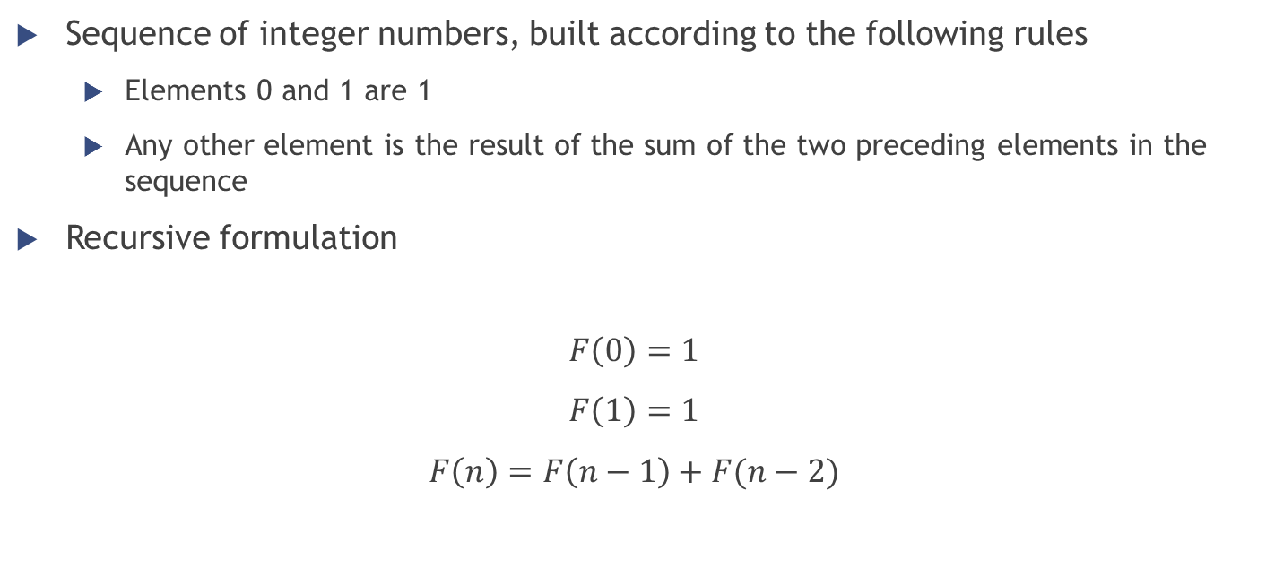
Fibonacci Sequence Definition
Sequence of integer numbers, built according to the following rules
Elements 0 and 1 are 1
Any other element is the result of the sum of the two preceding elements in the sequence
Recursive formulation
$$F\left(0\right)=1$$
$$F\left(1\right)=1$$
$$F\left(n\right)=F\left(n−1\right)+F(n−2)$$

Slide 6
Fibonacci Sequence Recursive function
function fib(n)
if n <= 1 return 1
return fib(n − 1) + fib(n − 2)
n | Time (ms)
30 | 4
35 | 50
40 | 550
45 | 5817
>50 | Happy watching!

Slide 7

Fibonacci Sequence Why so slow?
F(5)
F(4)
F(3)
F(3)
F(2)
F(2)
F(1)
F(2)
F(1)
F(1)
F(0)
F(1)
F(0)
F(1)
F(0)
Complexity = $O(2^{n})$

Slide 8
Fibonacci Sequence Why so slow?
“Did I ever tell you what the definition of insanity is? Insanity is doing the exact... same *** thing... over and over again expecting... things to change...”
We are doing the same thing over and over again
F(3) computed twice, F(2) computed three times...
Ideas on how to speed up the process?
We could save the result of sub-problems (= memoization)!

Slide 9
Fibonacci Sequence Memoization
Save the result of sub-problems into a data structure (called lookup table)
Before making a recursive call, we check the lookup table…
Sub-problem never solved yet? → Make the recursive call
Sub-problem already solved? → Read the result stored in the table
Add the result of the current recursive call to the lookup table

Slide 10
Fibonacci Sequence Memoized algorithm (recursive)
Suppose m is a map object which maps each value of fib that has already been calculated to its result
var m := map(0 → 1, 1 → 1)
function fib(n)
if key n is not in map m
m[n] := fib(n − 1) + fib(n − 2)
return m[n]

Slide 11
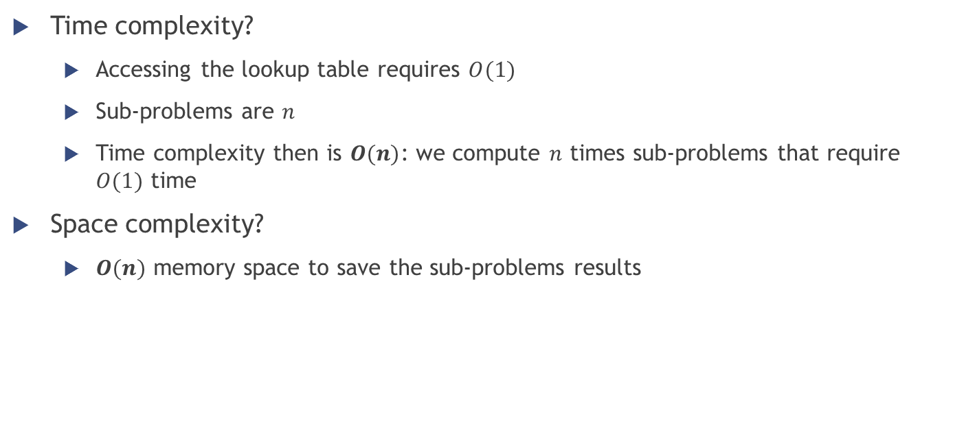
Fibonacci Sequence Memoization
var m := map(0 → 0, 1 → 1)
function fib(n)
if key n is not in map m
m[n] := fib(n − 1) + fib(n − 2)
return m[n]
Time complexity?
Accessing the lookup table requires $O(1)$
Sub-problems are $n$
Time complexity then is $O(n)$: we compute $n$ times sub-problems that require $O(1)$ time
Space complexity?
$O(n)$ memory space to save the sub-problems results

Slide 12

Fibonacci Sequence Bottom up algorithm (iterative)
Other possible approach
Build the result of the computation starting from the base case of the recursion
At each iteration save the intermediate results to use at the next step
Same time complexity $O(n)$ as the recursive version, but only $O(1)$ of space complexity
function fib(n)
if n = 0
return 1
else
var previousFib := 1, currentFib := 1
repeat n − 1 times // loop is skipped if n = 1
var newFib := previousFib + currentFib
previousFib := currentFib
currentFib := newFib
return currentFib

Slide 13
Floyd Warshall algorithm
All pairs shortest paths problem

Slide 14
Shortest path problem
Remember Dijkstra?
Shortest paths starting from ONE node to ALL other nodes
What if we need shortest paths from multiple source nodes?
Floyd-Warshall: shortest paths starting from ALL nodes to ALL nodes
Example of dynamic programming

Slide 15
Floyd-Warshall algorithm
Compares all possible paths through the graph between each pair of vertices
Every combination of edges is tested
It works by incrementally improving an estimate on the shortest path between two vertices, until the estimate is optimal
Based on a recursive idea

Slide 16
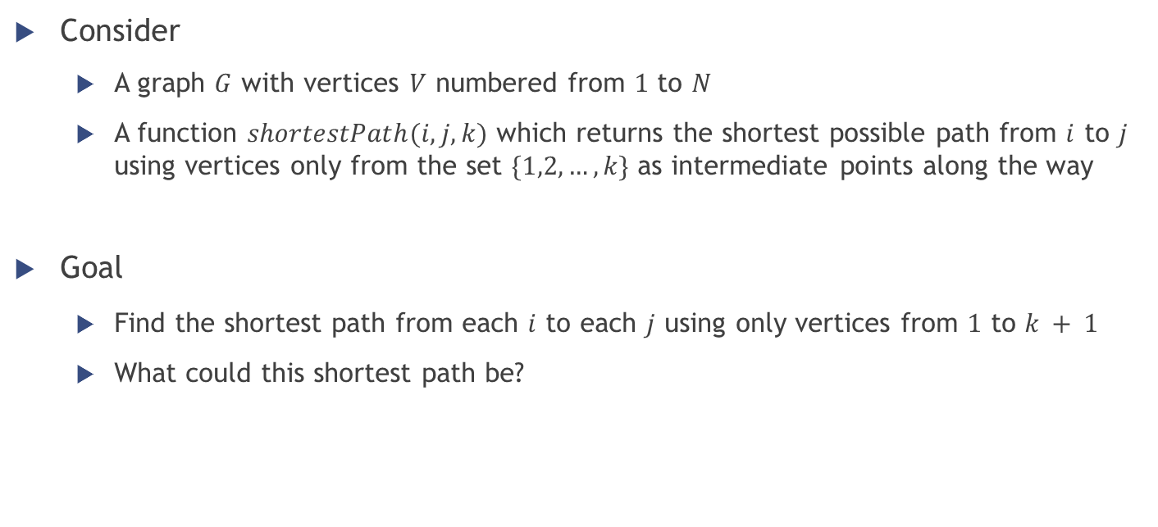
Floyd-Warshall algorithm
Consider
A graph $G$ with vertices $V$ numbered from $1$ to $N$
A function $shortestPath(i,j,k)$ which returns the shortest possible path from $i$ to $j$ using vertices only from the set $\{1,2,…,k\}$ as intermediate points along the way
Goal
Find the shortest path from each $i$ to each $j$ using only vertices from $1$ to $k + 1$
What could this shortest path be?

Slide 17
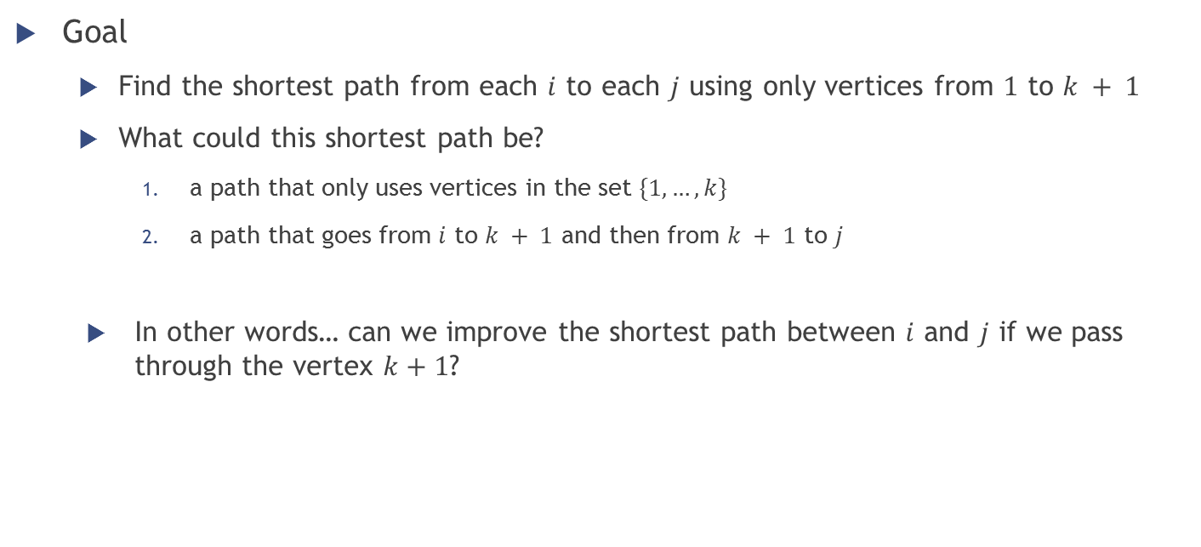
Floyd-Warshall algorithm
Goal
Find the shortest path from each $i$ to each $j$ using only vertices from $1$ to $k + 1$
What could this shortest path be?
a path that only uses vertices in the set $\{1, …, k\}$
a path that goes from $i$ to $k + 1$ and then from $k + 1$ to $j$
In other words… can we improve the shortest path between $i$ and $j$ if we pass through the vertex $k+1$?

Slide 18
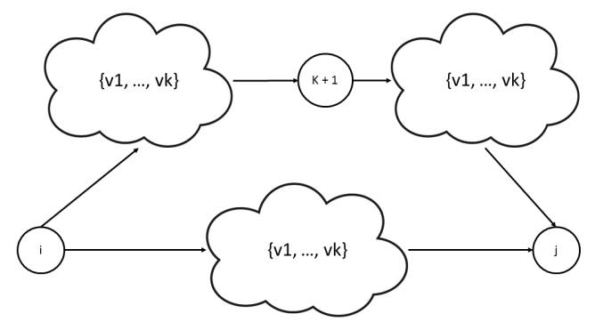

Floyd-Warshall algorithm
Can we improve the shortest path between $i$ and $j$ if we pass through the vertex $k+1$?

Slide 19

Floyd-Warshall algorithm
Can we improve the shortest path between $i$ and $j$ if we pass through the vertex $k+1$?
$$shortestPath\left(i,j,k+1\right)= min⁡(shortestPath(i,j,k), shortestPath(i,k+1,k) + shortestPath(k+1,j,k))$$

Slide 20

Floyd-Warshall algorithm
What is the base (easiest) case of $shortestPath(i,j,k)$?
$k = 0$ → the path between $i$ and $j$ does not involve any other vertex
Length of the path = weight of the edge $w(i,j)$
Remember that if two vertices are not directly connected, then $w\left(i,j\right)=∞$

Slide 21
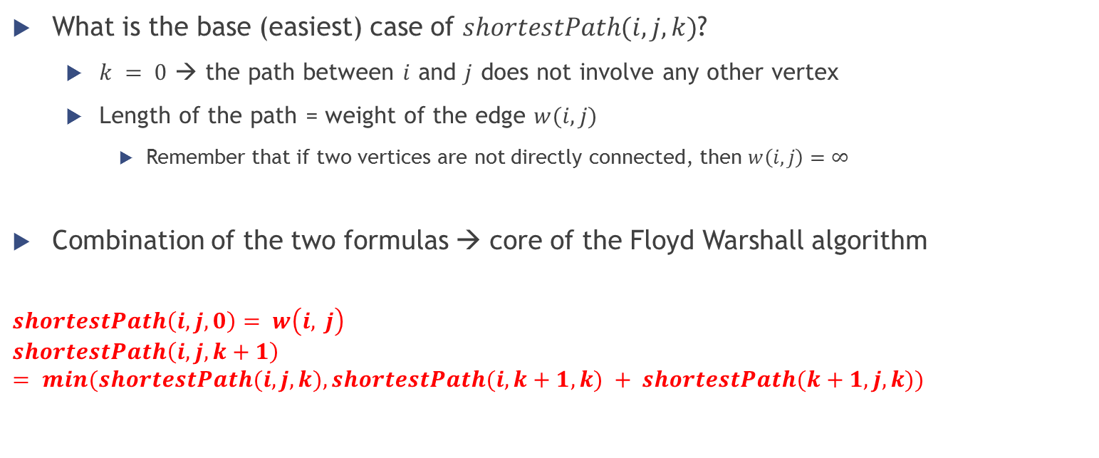
Floyd-Warshall algorithm
What is the base (easiest) case of $shortestPath(i,j,k)$?
$k = 0$ → the path between $i$ and $j$ does not involve any other vertex
Length of the path = weight of the edge $w(i,j)$
Remember that if two vertices are not directly connected, then $w\left(i,j\right)=∞$
Combination of the two formulas → core of the Floyd Warshall algorithm
$$shortestPath\left(i,j, 0\right)= w\left(i, j\right)$$
$$shortestPath\left(i,j,k+1\right)= min⁡(shortestPath(i,j,k), shortestPath(i,k+1,k) + shortestPath(k+1,j,k))$$

Slide 22
Floyd-Warshall and dynamic programming
1
3
4
2
5
1
1
2
10
We are recomputing the same paths multiple times, for example:
sp(1,2,4) = min(sp(1,2,3),sp(1,4,3) + sp(4,2,3))
sp(1,2,3) = min(sp(1,2,2),sp(1,3,2) + sp(3,2,2))
sp(1,4,3) = min(sp(1,4,2),sp(1,3,2) + sp(3,4,2))

Slide 23
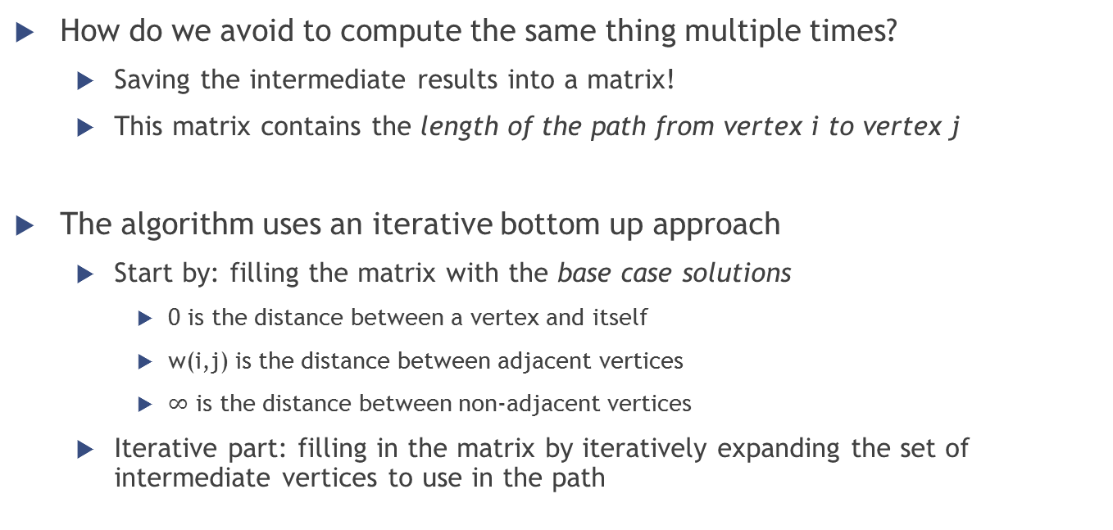
Floyd-Warshall memoization
How do we avoid to compute the same thing multiple times?
Saving the intermediate results into a matrix!
This matrix contains the length of the path from vertex i to vertex j
The algorithm uses an iterative bottom up approach
Start by: filling the matrix with the base case solutions
0 is the distance between a vertex and itself
w(i,j) is the distance between adjacent vertices
$∞$ is the distance between non-adjacent vertices
Iterative part: filling in the matrix by iteratively expanding the set of intermediate vertices to use in the path

Slide 24
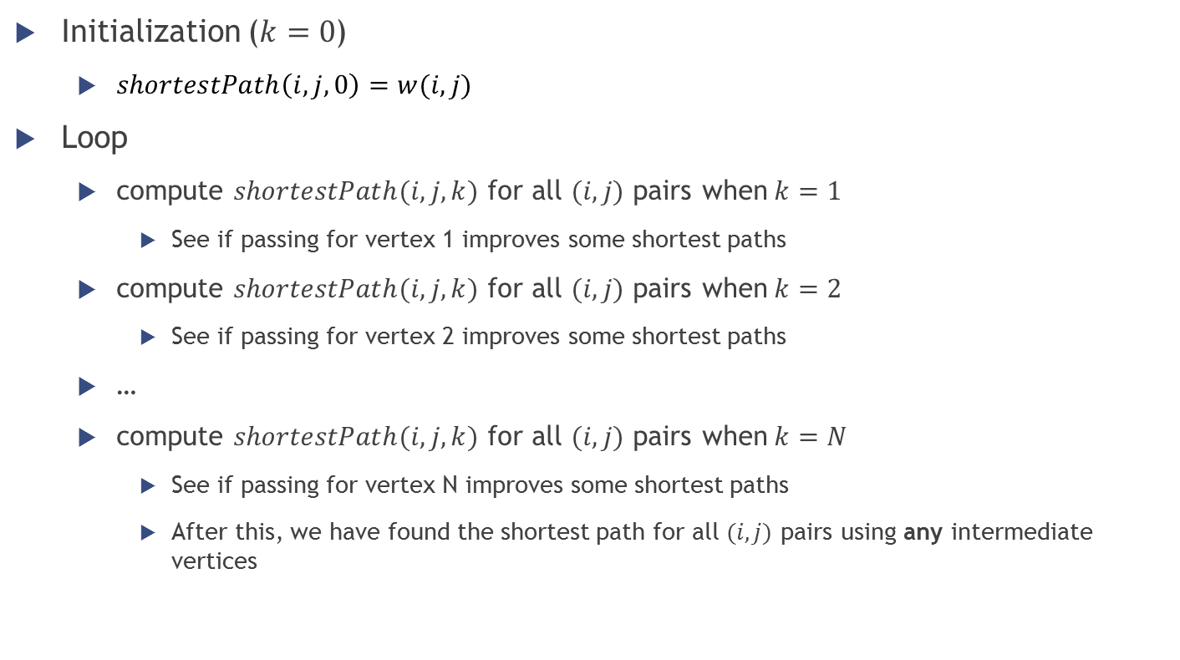
Floyd-Warshall algorithm
Initialization ($k=0$)
$shortestPath\left(i,j, 0\right)=w(i,j)$
Loop
compute $shortestPath(i, j, k)$ for all $(i, j)$ pairs when$k=1$
See if passing for vertex 1 improves some shortest paths
compute $shortestPath(i, j, k)$ for all $(i, j)$ pairs when$k=2$
See if passing for vertex 2 improves some shortest paths
…
compute $shortestPath(i, j, k)$ for all $(i, j)$ pairs when$k=N$
See if passing for vertex N improves some shortest paths
After this, we have found the shortest path for all $(i, j)$ pairs using any intermediate vertices

Slide 25
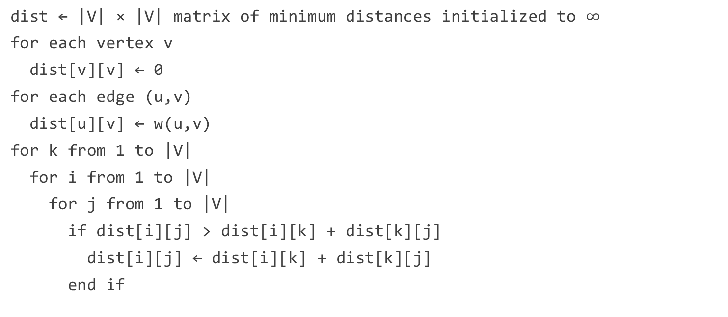
Floyd-Warshall algorithm
dist ← |V| × |V| matrix of minimum distances initialized to $∞$
for each vertex v
dist[v][v] ← 0
for each edge (u,v)
dist[u][v] ← w(u,v)
for k from 1 to |V|
for i from 1 to |V|
for j from 1 to |V|
if dist[i][j] > dist[i][k] + dist[k][j]
dist[i][j] ← dist[i][k] + dist[k][j]
end if

Slide 26

Floyd-Warshall algorithm
Previous code only computed the minimum distance between pairs of vertices, but not the actual minimum path
Small changes to the algorithm make it possible to save also the information on the actual path
dist ← |V| × |V| matrix of minimum distances initialized to $∞$
next ← |V| × |V| matrix of vertex indices initialized to null
for each edge (u,v)
dist[u][v] ← w(u,v)
next[u][v] ← v
for k from 1 to |V|
for i from 1 to |V|
for j from 1 to |V|
if dist[i][k] + dist[k][j] < dist[i][j] then
dist[i][j] ← dist[i][k] + dist[k][j]
next[i][j] ← next[i][k]
Notes:
procedure Path(u, v) if next[u][v] = null then return [] path = [u] while u ≠ v u ← next[u][v] path.append(u) return path
https://en.wikipedia.org/wiki/Floyd%E2%80%93Warshall_algorithm#Path_reconstruction

Slide 27

Floyd-Warshall algorithm
Complexity?
Three nested loops
Each loop performs $|V|$ iterations
$\left|V\right|×\left|V\right|×\left|V\right|$ iterations in total → $O\left({\left|V\right|}^{3}\right)$
Or, if we call $n$ the number of nodes ($|V|$), $O\left(n^{3}\right)$

Slide 28
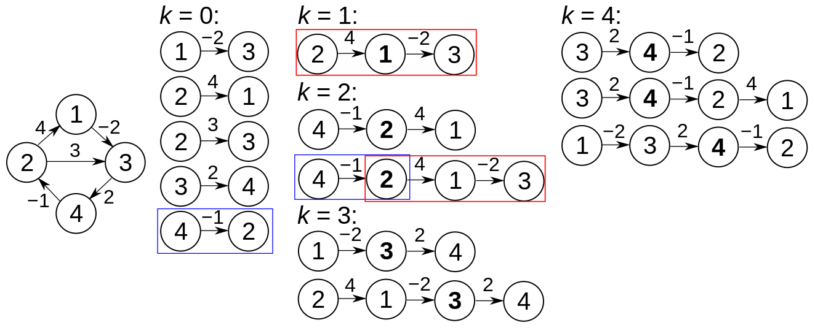
Floyd-Warshall algorithm
Example
Notes:
Prior to the first iteration of the outer loop, labeled k=0 above, the only known paths correspond to the single edges in the graph. At k=1, paths that go through the vertex 1 are found: in particular, the path 2→1→3 is found, replacing the path 2→3 which has fewer edges but is longer. At k=2, paths going through the vertices {1,2} are found. The red and blue boxes show how the path 4→2→1→3 is assembled from the two known paths 4→2 and 2→1→3 encountered in previous iterations, with 2 in the intersection. The path 4→2→3 is not considered, because 2→1→3 is the shortest path encountered so far from 2 to 3. At k=3, paths going through the vertices {1,2,3} are found. Finally, at k=4, all shortest paths are found.

Slide 29
Floyd-Warshall algorithm
Example
Notes:
Prior to the first iteration of the outer loop, labeled k=0 above, the only known paths correspond to the single edges in the graph. At k=1, paths that go through the vertex 1 are found: in particular, the path 2→1→3 is found, replacing the path 2→3 which has fewer edges but is longer. At k=2, paths going through the vertices {1,2} are found. The red and blue boxes show how the path 4→2→1→3 is assembled from the two known paths 4→2 and 2→1→3 encountered in previous iterations, with 2 in the intersection. The path 4→2→3 is not considered, because 2→1→3 is the shortest path encountered so far from 2 to 3. At k=3, paths going through the vertices {1,2,3} are found. Finally, at k=4, all shortest paths are found.

Slide 30
Floyd-Warshall algorithm
Example
Notes:
Prior to the first iteration of the outer loop, labeled k=0 above, the only known paths correspond to the single edges in the graph. At k=1, paths that go through the vertex 1 are found: in particular, the path 2→1→3 is found, replacing the path 2→3 which has fewer edges but is longer. At k=2, paths going through the vertices {1,2} are found. The red and blue boxes show how the path 4→2→1→3 is assembled from the two known paths 4→2 and 2→1→3 encountered in previous iterations, with 2 in the intersection. The path 4→2→3 is not considered, because 2→1→3 is the shortest path encountered so far from 2 to 3. At k=3, paths going through the vertices {1,2,3} are found. Finally, at k=4, all shortest paths are found.

Slide 31
Floyd-Warshall algorithm
Example
Notes:
Prior to the first iteration of the outer loop, labeled k=0 above, the only known paths correspond to the single edges in the graph. At k=1, paths that go through the vertex 1 are found: in particular, the path 2→1→3 is found, replacing the path 2→3 which has fewer edges but is longer. At k=2, paths going through the vertices {1,2} are found. The red and blue boxes show how the path 4→2→1→3 is assembled from the two known paths 4→2 and 2→1→3 encountered in previous iterations, with 2 in the intersection. The path 4→2→3 is not considered, because 2→1→3 is the shortest path encountered so far from 2 to 3. At k=3, paths going through the vertices {1,2,3} are found. Finally, at k=4, all shortest paths are found.

Slide 32
Floyd-Warshall algorithm
Example
Notes:
Prior to the first iteration of the outer loop, labeled k=0 above, the only known paths correspond to the single edges in the graph. At k=1, paths that go through the vertex 1 are found: in particular, the path 2→1→3 is found, replacing the path 2→3 which has fewer edges but is longer. At k=2, paths going through the vertices {1,2} are found. The red and blue boxes show how the path 4→2→1→3 is assembled from the two known paths 4→2 and 2→1→3 encountered in previous iterations, with 2 in the intersection. The path 4→2→3 is not considered, because 2→1→3 is the shortest path encountered so far from 2 to 3. At k=3, paths going through the vertices {1,2,3} are found. Finally, at k=4, all shortest paths are found.

Slide 33
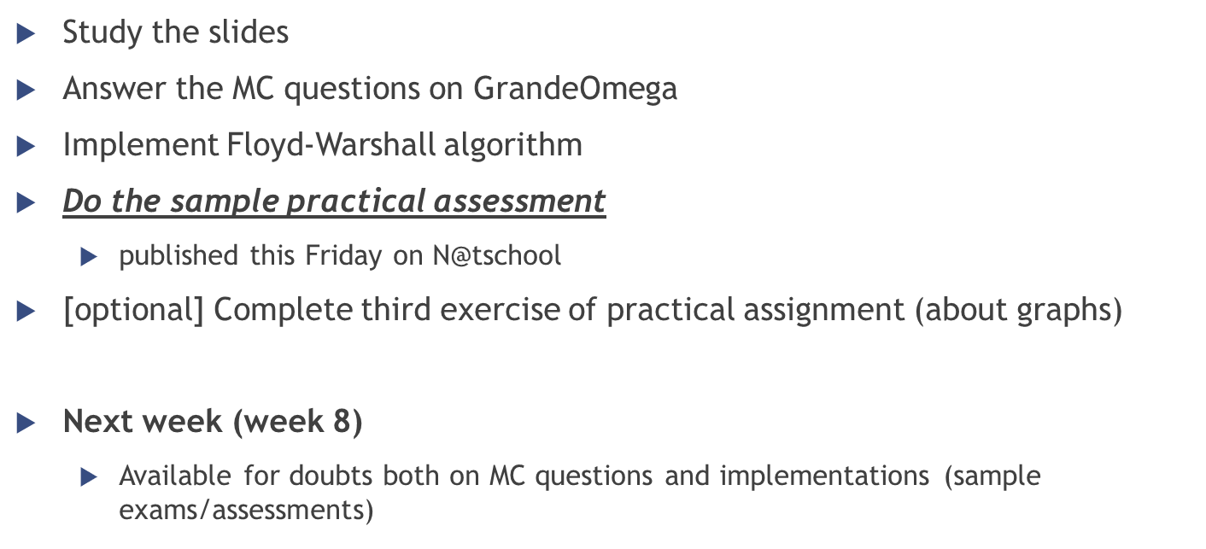
Homework
Study the slides
Answer the MC questions on GrandeOmega
Implement Floyd-Warshall algorithm
Do the sample practical assessment
published this Friday on N@tschool
[optional] Complete third exercise of practical assignment (about graphs)
Next week (week 8)
Available for doubts both on MC questions and implementations (sample exams/assessments)

Slide 34

Sample written exam
Open laptop/tablet/smartphone and use Chrome
Login on GrandeOmega
Open “Sample exam” and wait for authorization
Try to make it as you would during the real exam
without looking at the slides
without talking with your friends
20 questions
50 minutes
Pass if the amount of correct answers is >= 11

